Slide 1
P.R.I.D.E.
Presented by:
Jeremy Diederich
Designed by:
Jeremy Diederich
Luke Conway
Tom Hagen
( Created in partnership with Purdue Northwest Student Government)

Slide 2
What is P.R.I.D.E.?

Slide 3
P.R.I.D.E.
Professor
Review
Input
Data
Evaluation

Slide 4
The PRIDE System (cont.)
Professors’
This system is an inclusive and comprehensive approach to information gathering, including input from the Professors it concerns
Review
PRIDE allows for a scrutinized and consistent reviews of Professors’ performances and classes by students, for students
Input
Students will fill out an easy-to-use yet comprehensive form including the type of homework, how class points are allocated, and the usage of books and lecture notes

Slide 5
The PRIDE System (cont.)
Data
Information regarding Professor credentials, course content, and student feedback is compiled on the site
Evaluation
All data and feedback is scrutinized for accuracy and fairness, and upon approval is submitted to a comprehensive database accessible to all students of the University

Slide 6
PRIDE Rating
PRIDE’s rating is based on classroom content and the nature of the course
Students will input data pertaining to class work
The review asks what percentage of the student’s grade was attributed to various components, such as quizzes and in-class participation.

Slide 7
Goals of PRIDE
Increase Registration Efficiency
This database aims to relieve stresses on the registration process made by students changing classes during the semester
Raise Student Preparedness
Students beginning classes will have a better grasp of the classes at the outset, increasing the likelihood of higher moral
Enhance Academic Performance
Preparedness also increases the potential performance of students

Slide 8
Page Design

Slide 9
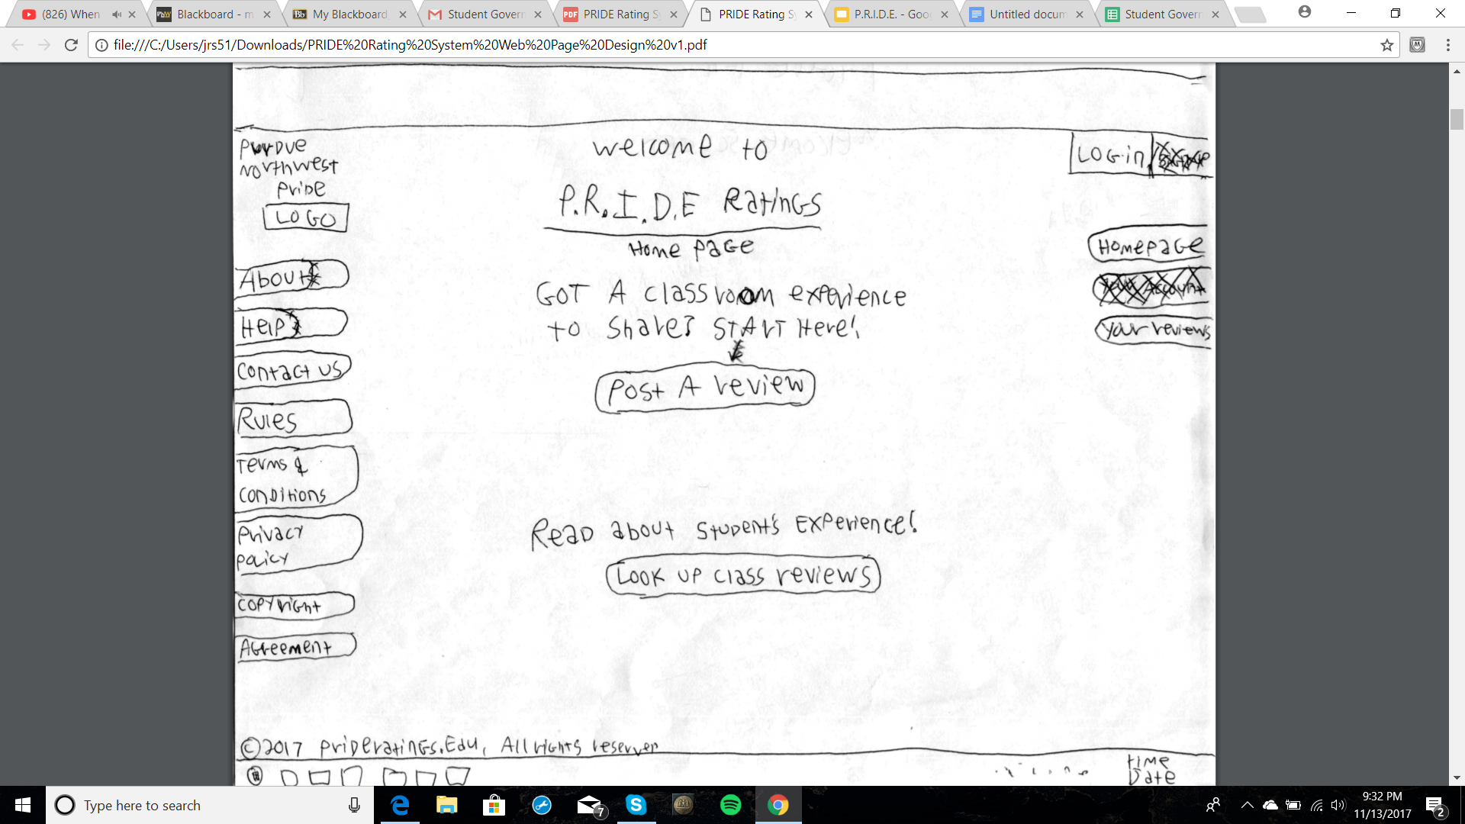
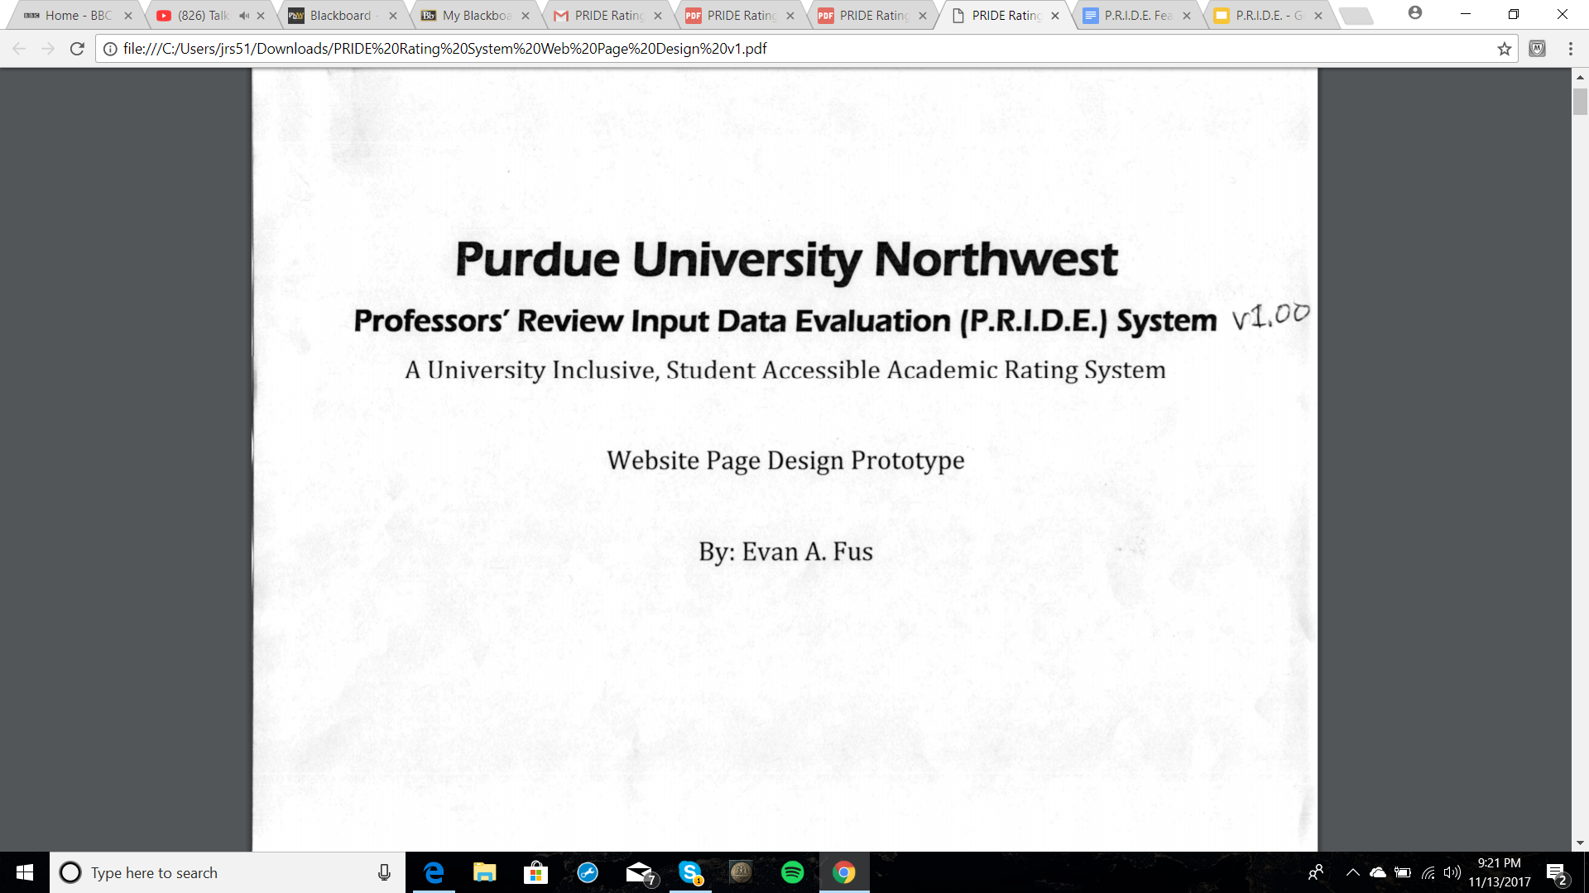
Home Page
Two links pertaining to PRIDE’s two main functions, submitting and accessing reviews, are featured center of the home page.

Slide 10
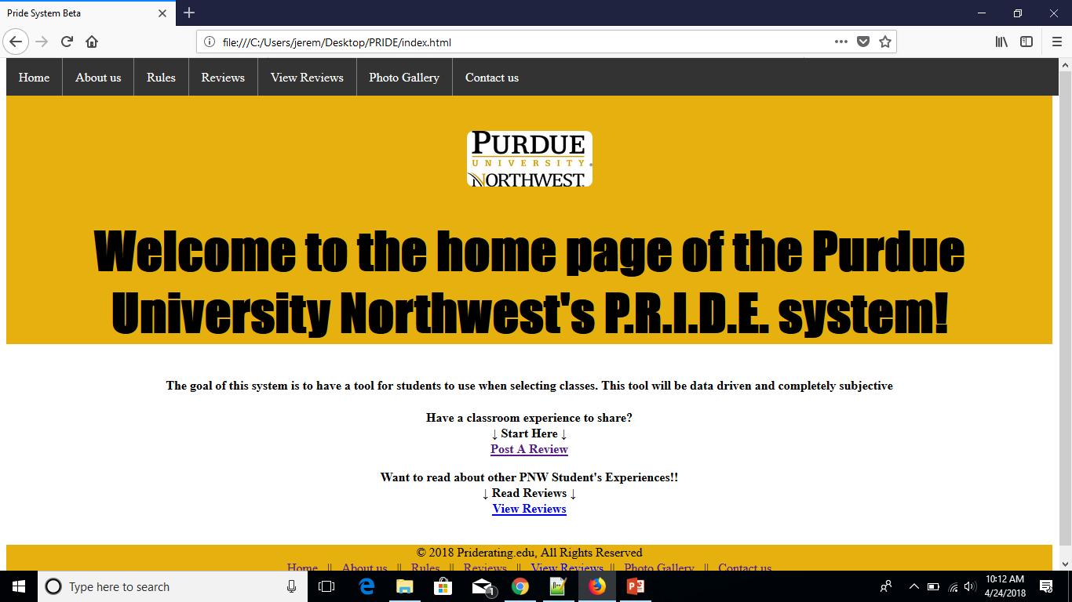
Home Page

Slide 11
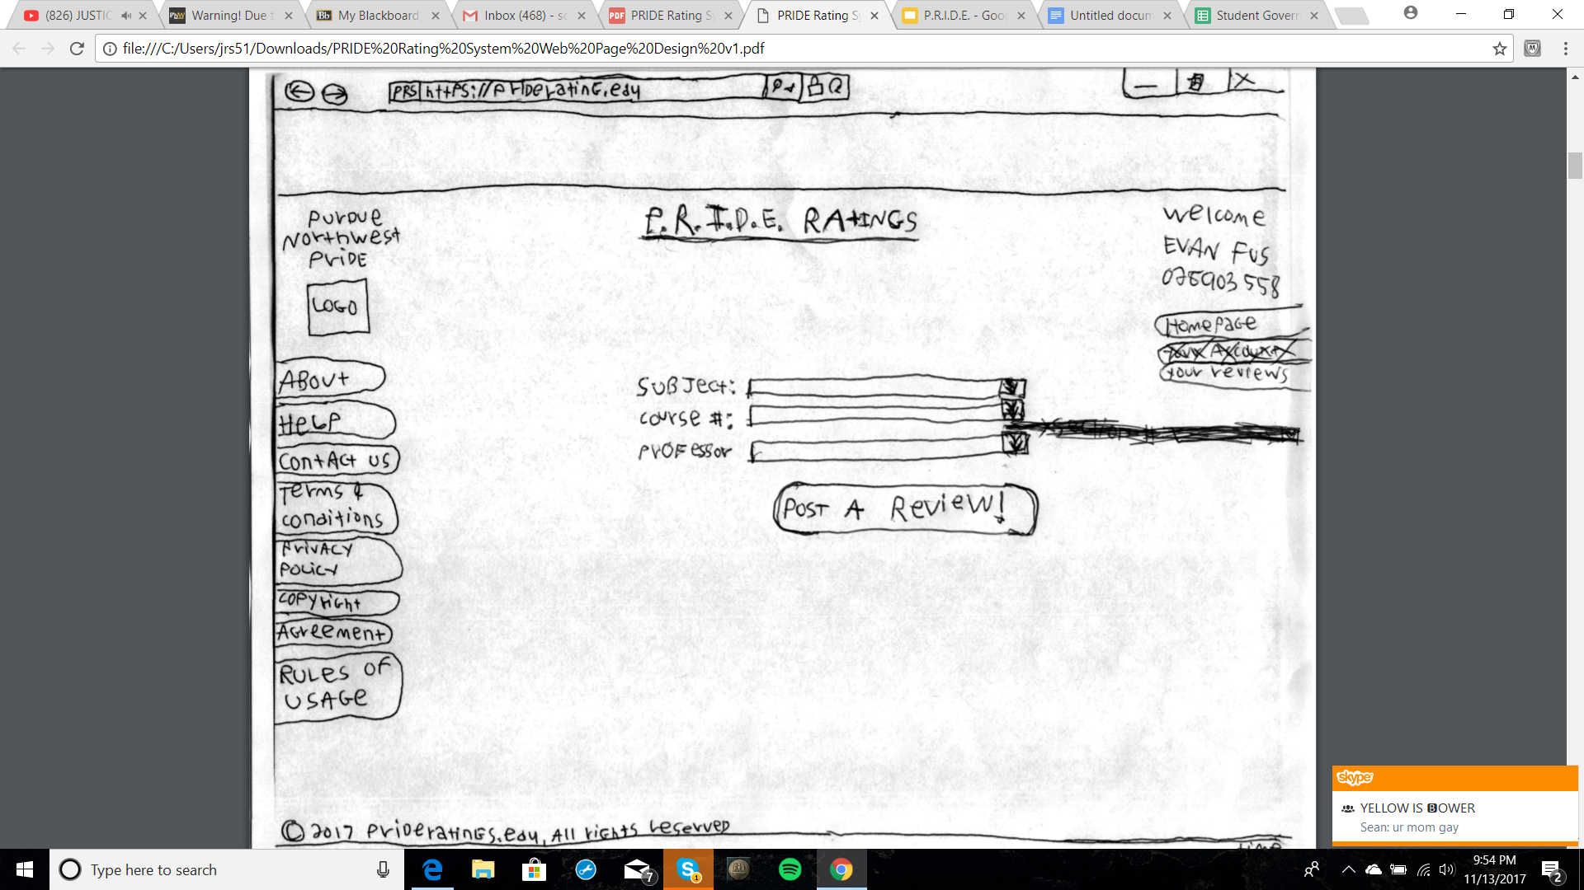
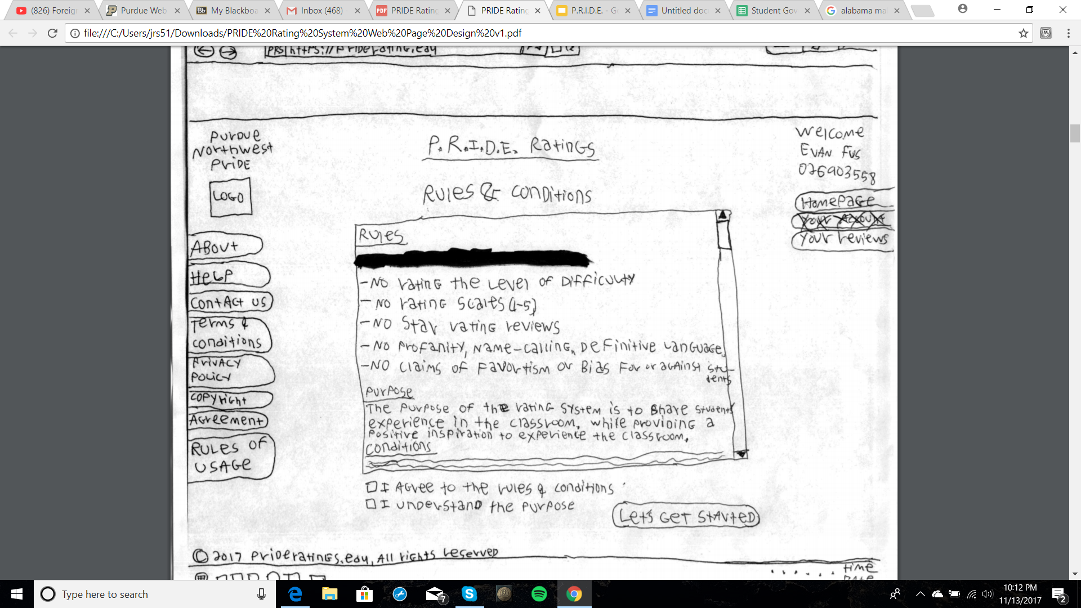
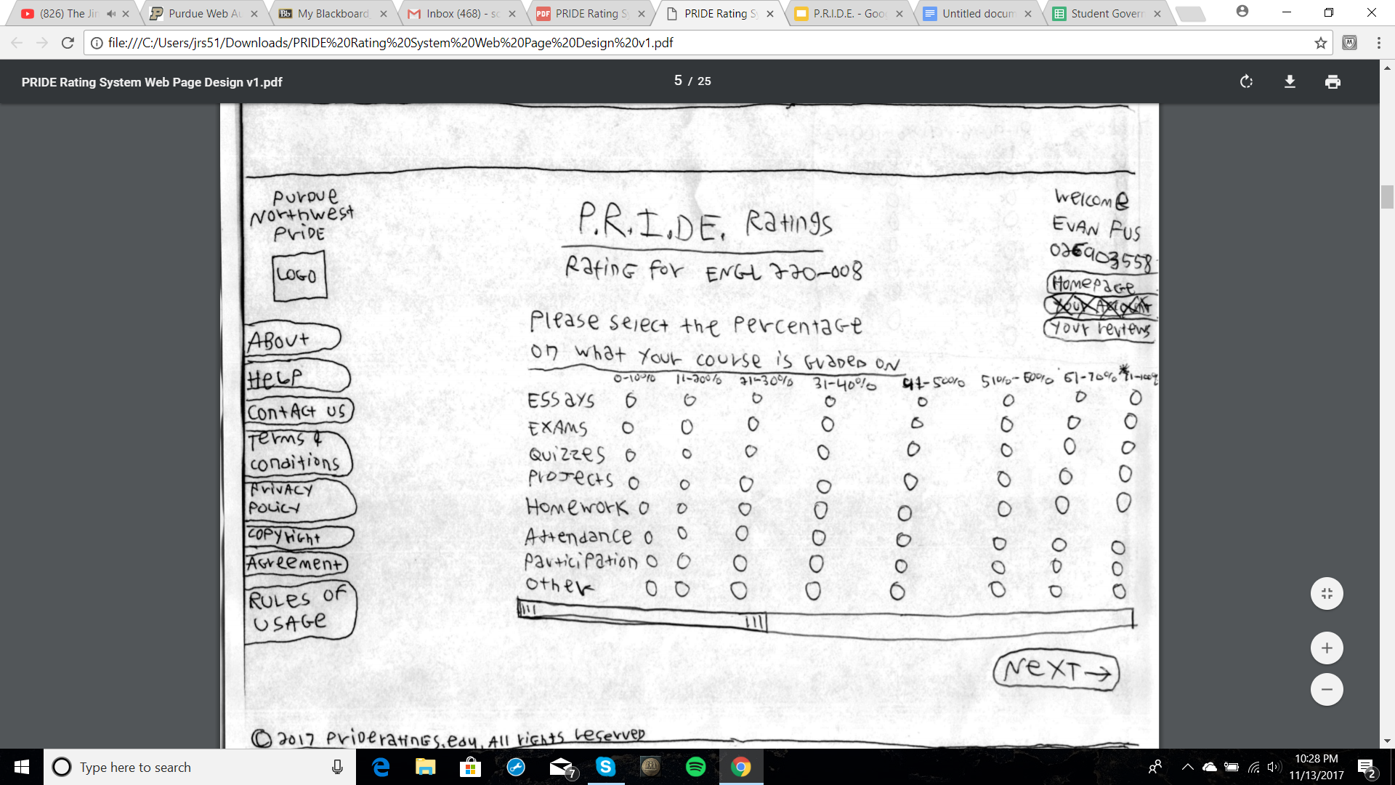
Review Submission

Slide 12
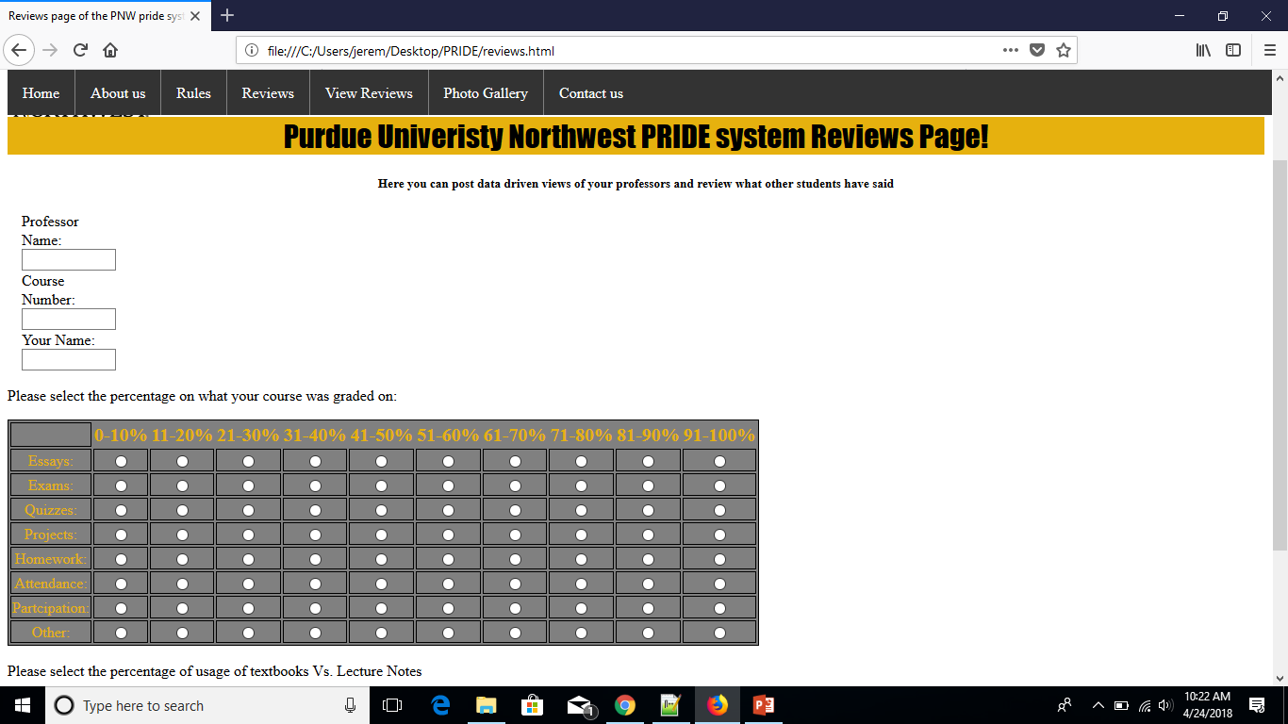
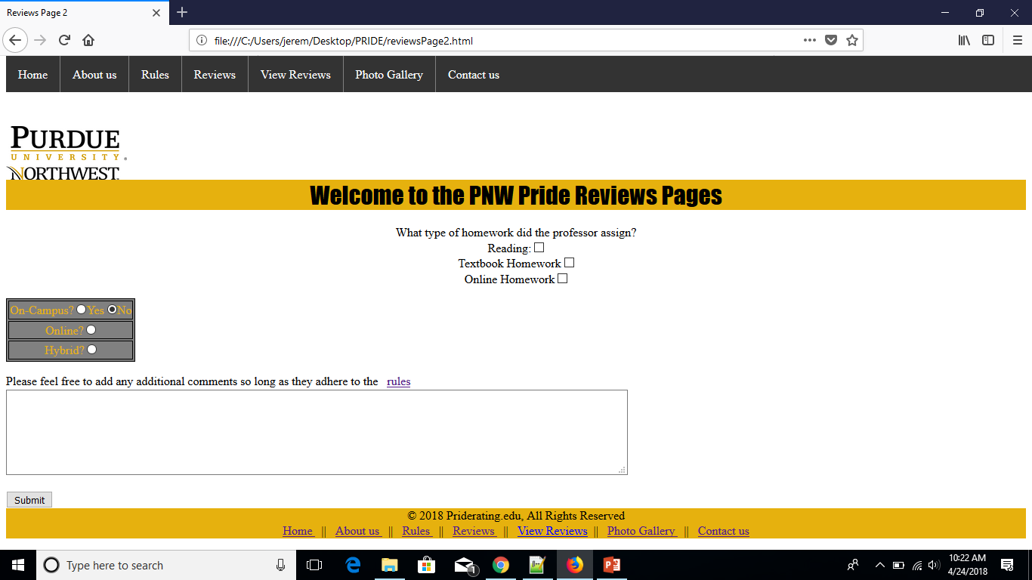
Review Submission

Slide 13
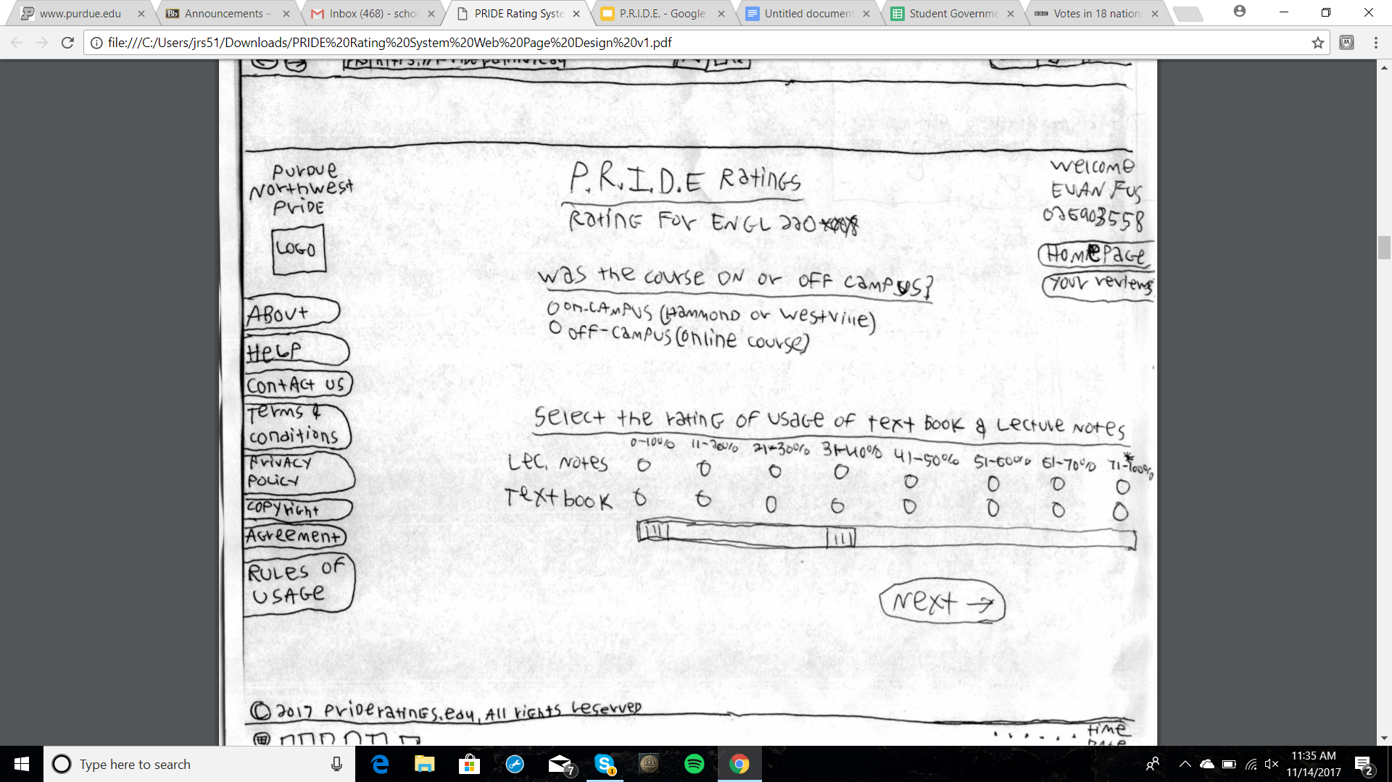
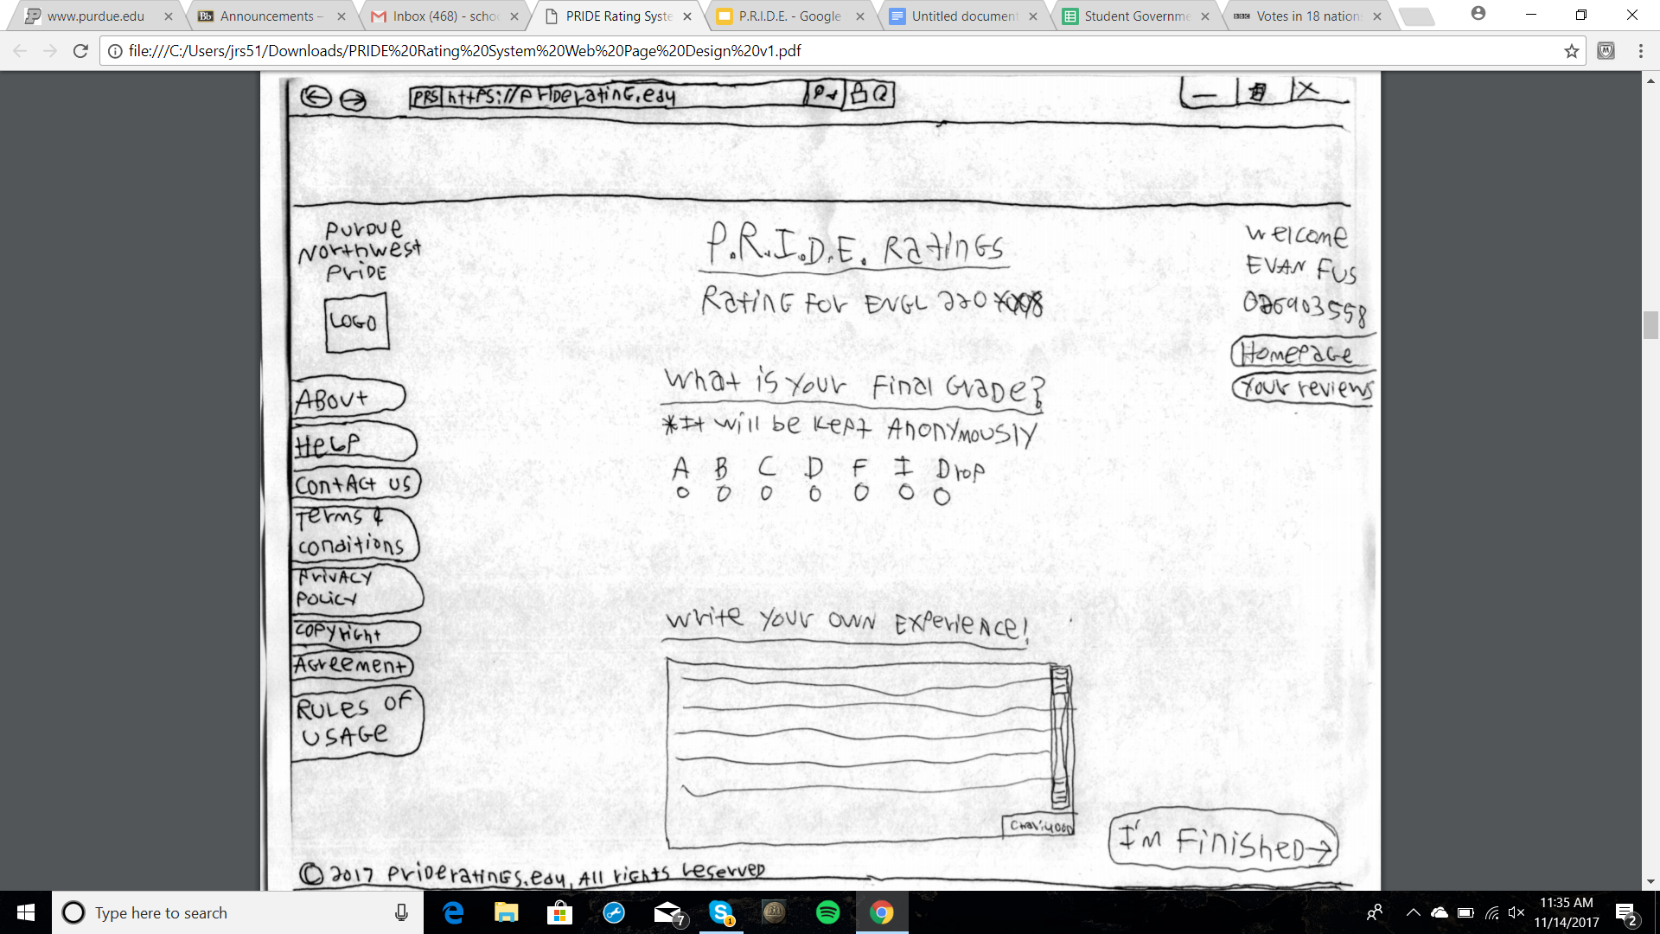
Submission Continued
Students continue through the submission process, inputting percentages of course material, amount of notes, and final grade received in the class. Upon completion of the submission students are returned to the home page.

Slide 14
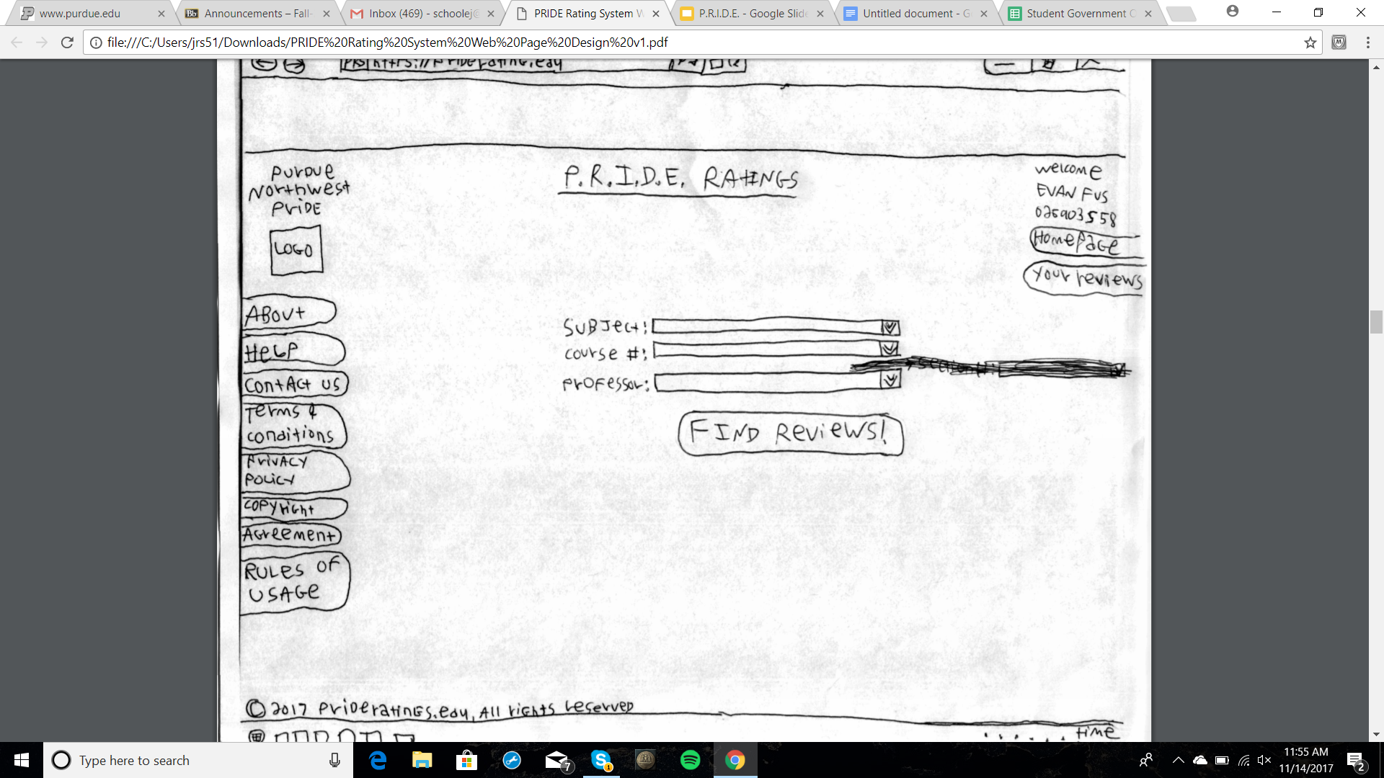
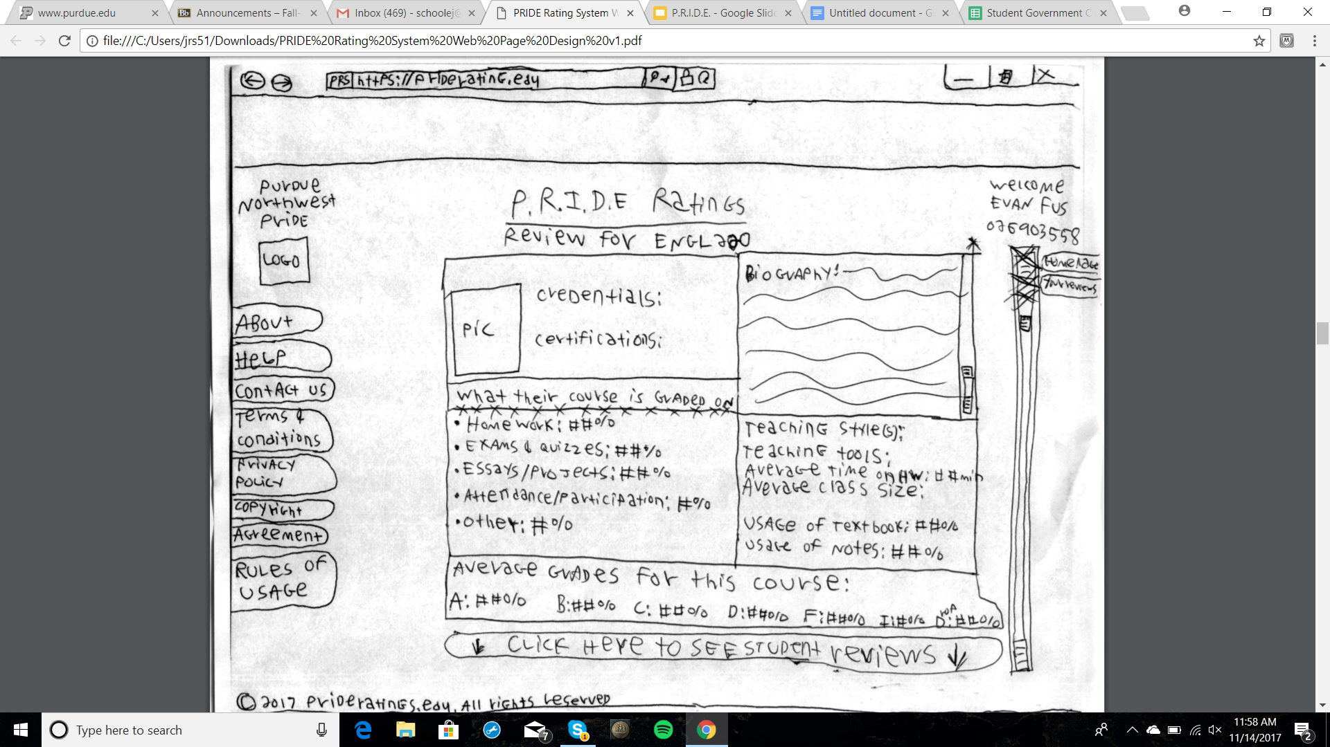
Review Retrieval
Students are able to retrieve and filter views from a drop down menu linked to an database archive of reviews from the past 5 years.

Slide 15
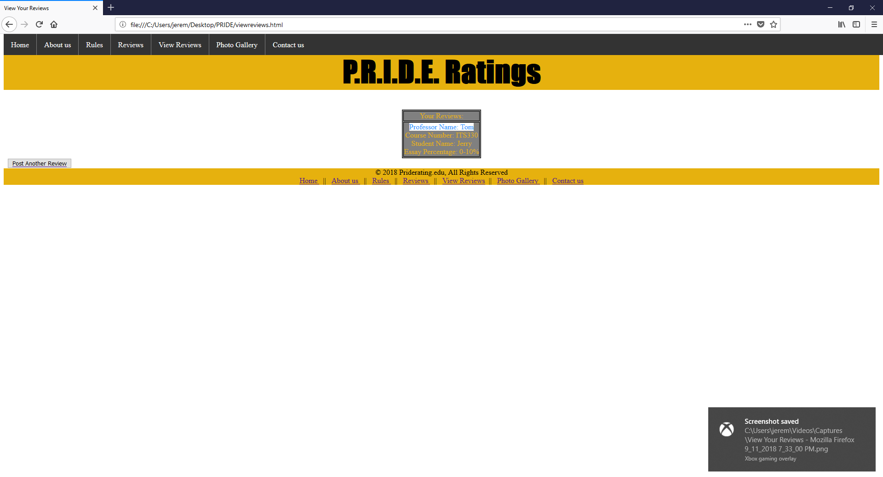
Review Retrieval
Opted for slightly different approach in prototyping the design.
Table structure with multiple rows of data.

